Slide 1
SMART HEALTHCARE SYSTEM FOR PATIENTS USING IOT TECHNOLOGY

Slide 2
Project submitted by :
Guided by :
R.KISHORE - 221005032
R.NAVANEEDHA KRISHNAN - 221005042
M.SALMON FAROSE - 221005051
Prof R.SANTHI
DEPARTMENT OF EEE
SASTRA DEEMED TO BE UNIVERSITY
SRINIVASA RAMANUJAN CENTER

Slide 3
Introduction:
The number of people prone to heart,lung diseases are alarmingly increasing. The fact is that the patient has to be given the proper first aid to save his/her life. Proper first aid requires diagnosis of body parameters such as ECG,Blood pressure,Temperature etc. Sending these parameters to a remote place is possible now using the IOT technology. It uses a wifi module and sensors to send the critical parameters to a remotely located doctor.

Slide 4
Hardware Requirements:
Arduino Board
ESP8266-01
LCD Display
Potentiometer
Pulse Sensor
Temperature Sensor
Resistor - 1K,2K
LED
Connecting Wires
Breadboard

Slide 5
Tools Used:
Arduino IDE
ThinkSpeak Cloud Service

Slide 6
Abstract:
This project aims at sending the critical parameters of the patient through a wifi module to a remotely located doctor. Considering the economical aspects,this project helps in achieving the delivery of data to a remote location with less cost when compared with other medical equipments used to analyse the parameters. The Wifi module connects to a smartphone using the iot technology to view the parameters to give immediate first aid to the patient in the ambulance itself.

Slide 7
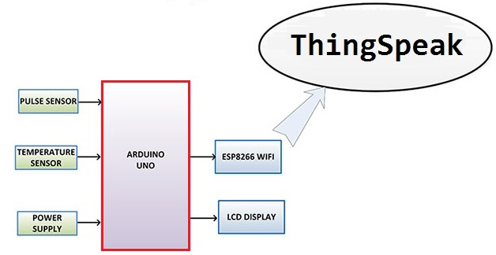
Block Diagram:

Slide 8
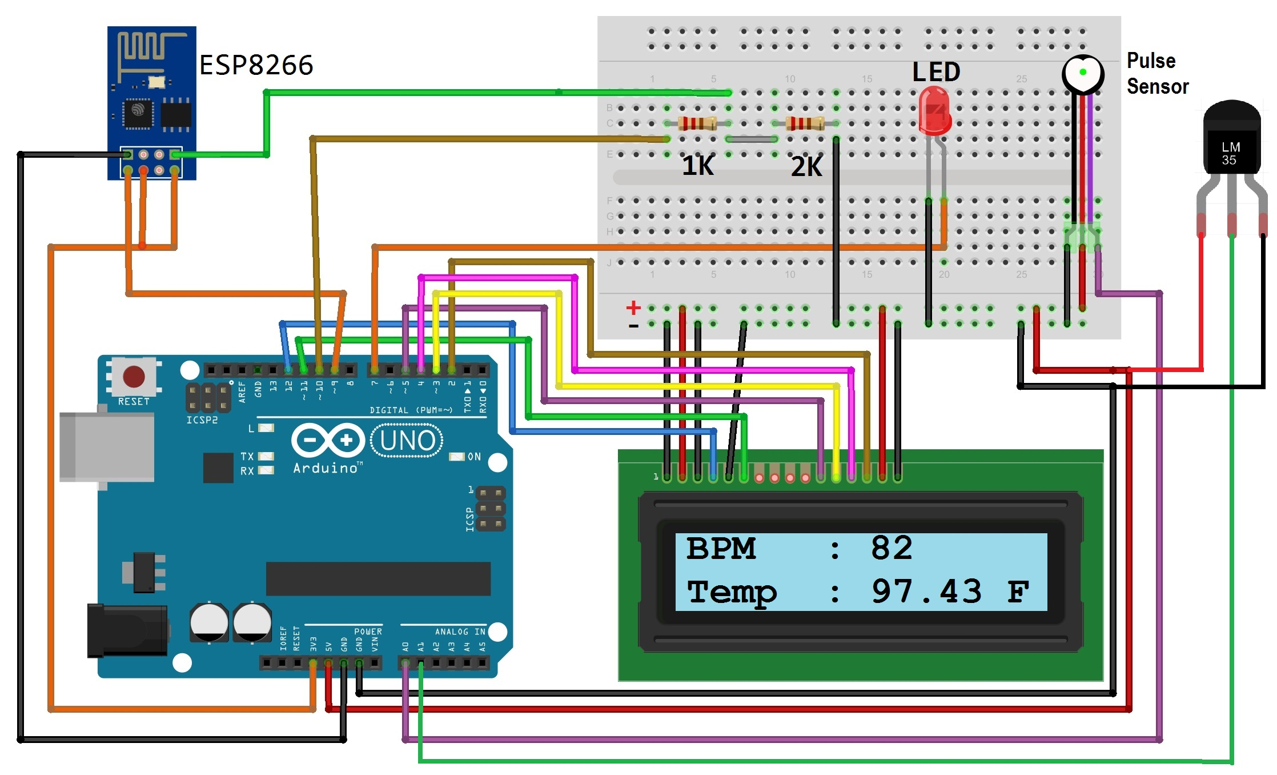
Circuit Diagram:

Slide 9
Circuit Connections:
Connect Pulse Sensor output pin to A0 of Arduino and other two pins to VCC & GND.
Connect LM35 Temperature Sensor output pin to A1 of Arduino and other two pins to VCC & GND.
Connect the LED to Digital Pin 7 of Arduino via a 220-ohm resistor.
Connect Pin 1,3,5,16 of LCD to GND.
Connect Pin 2,15 of LCD to VCC.
Connect Pin 4,6,11,12,13,14 of LCD to Digital Pin12,11,5,4,3,2 of Arduino.
The RX pin of ESP8266 works on 3.3V and it will not communicate with the Arduino when we will connect it directly to the Arduino. So, we will have to make a voltage divider for it which will convert the 5V into 3.3V. This can be done by connecting the 2.2K & 1K resistor. Thus the RX pin of the ESP8266 is connected to pin 10 of Arduino through the resistors.
Connect the TX pin of the ESP8266 to pin 9 of the Arduino.

Slide 10
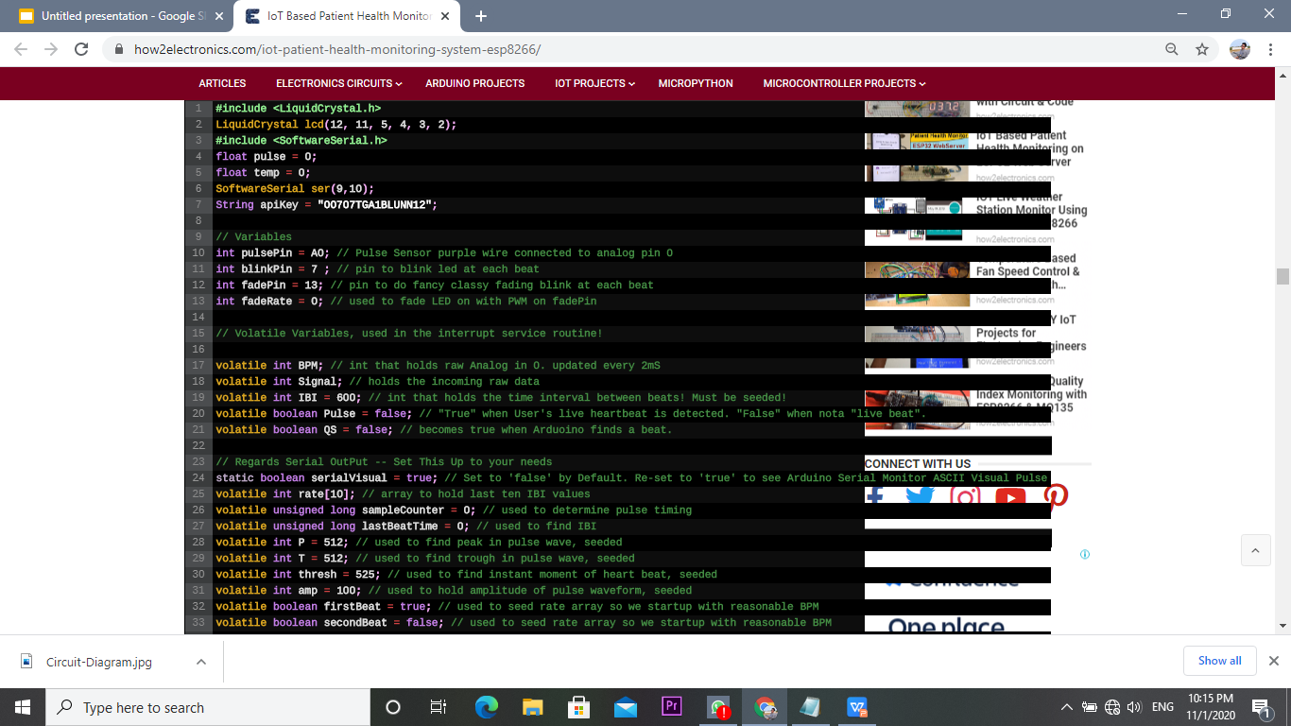
Program Used:

Slide 11
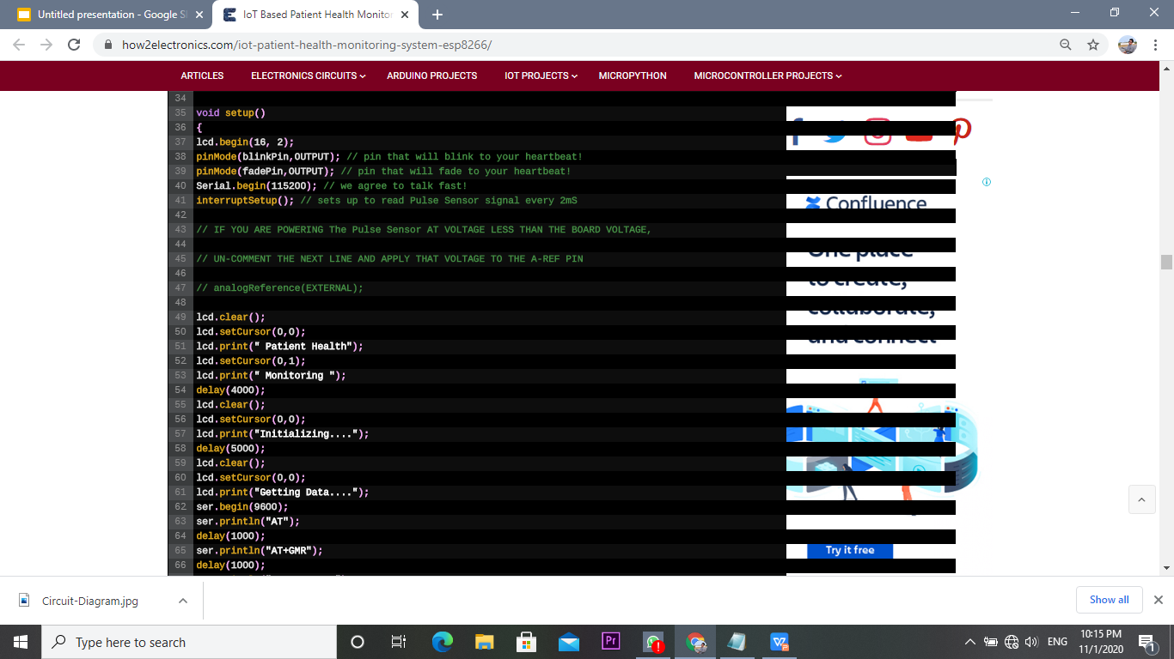

Slide 12
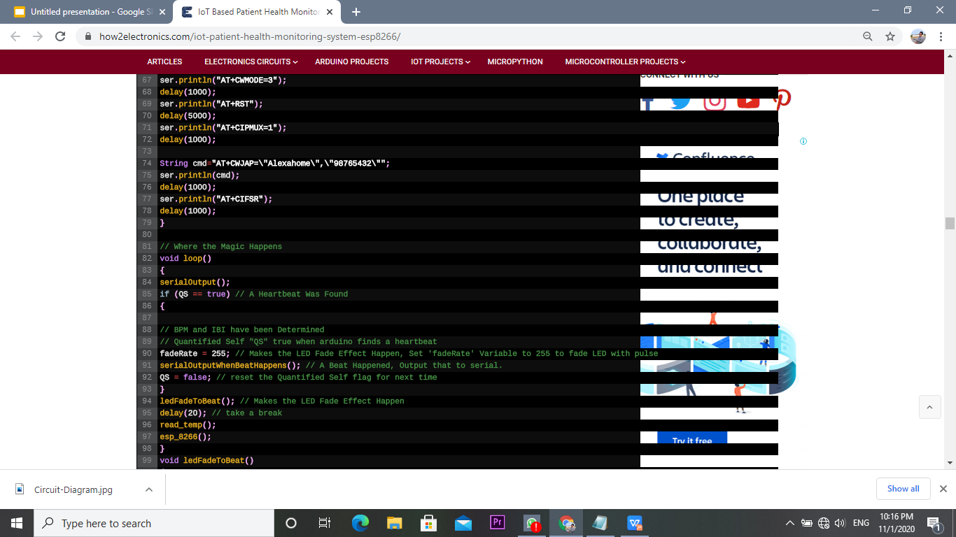

Slide 13
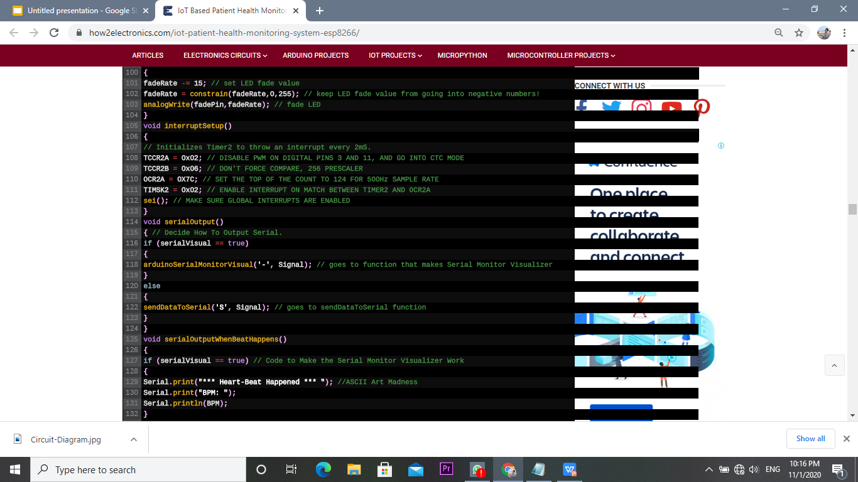

Slide 14
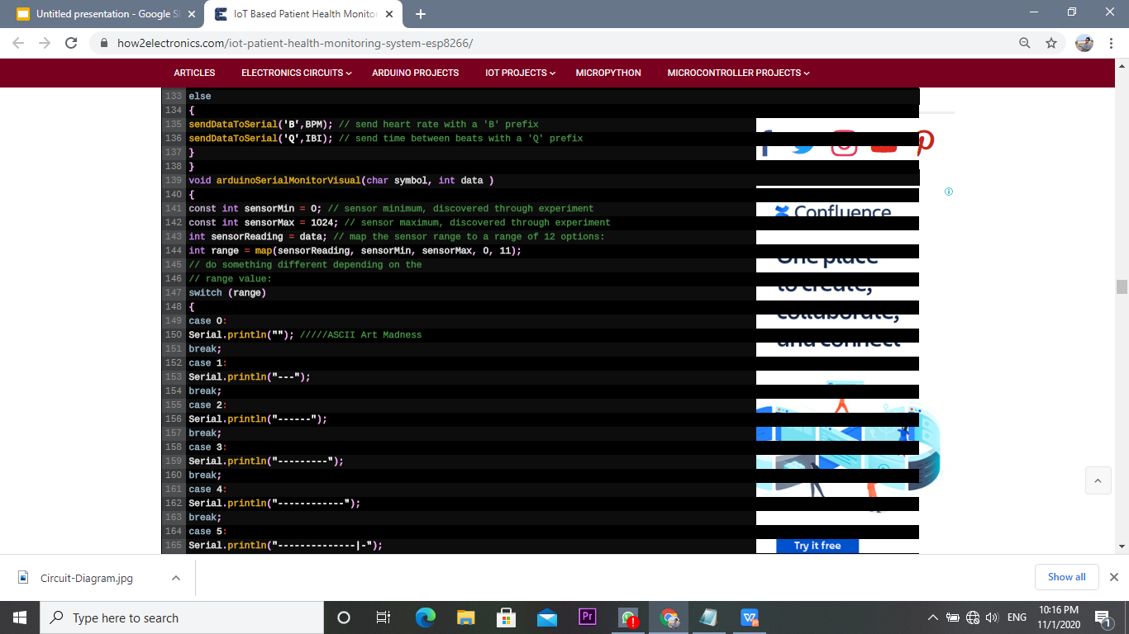

Slide 15
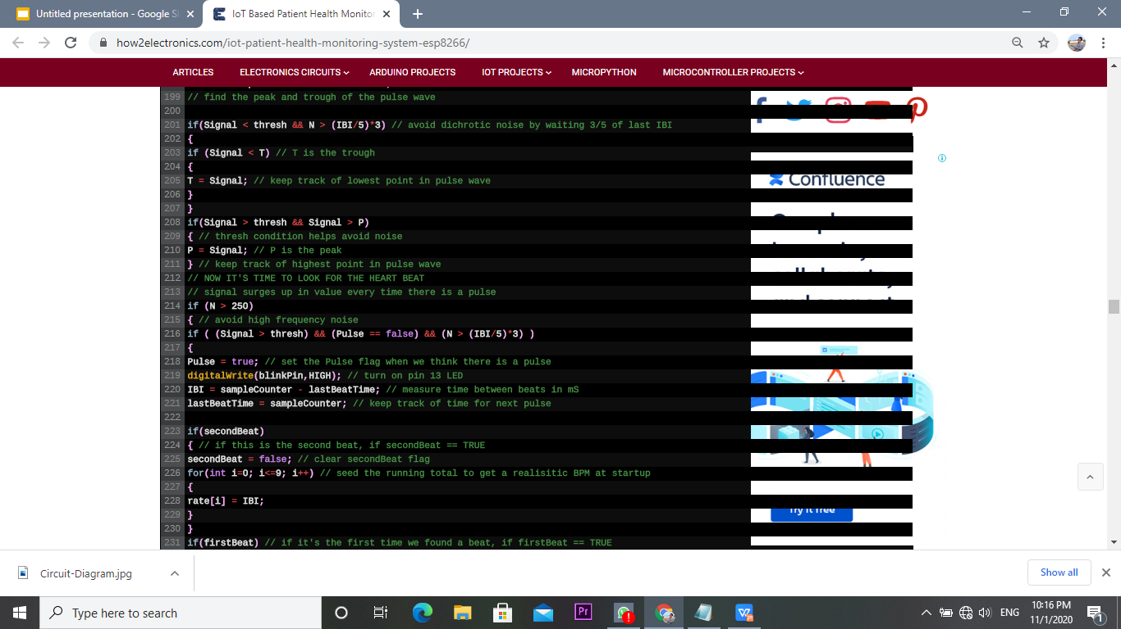

Slide 16
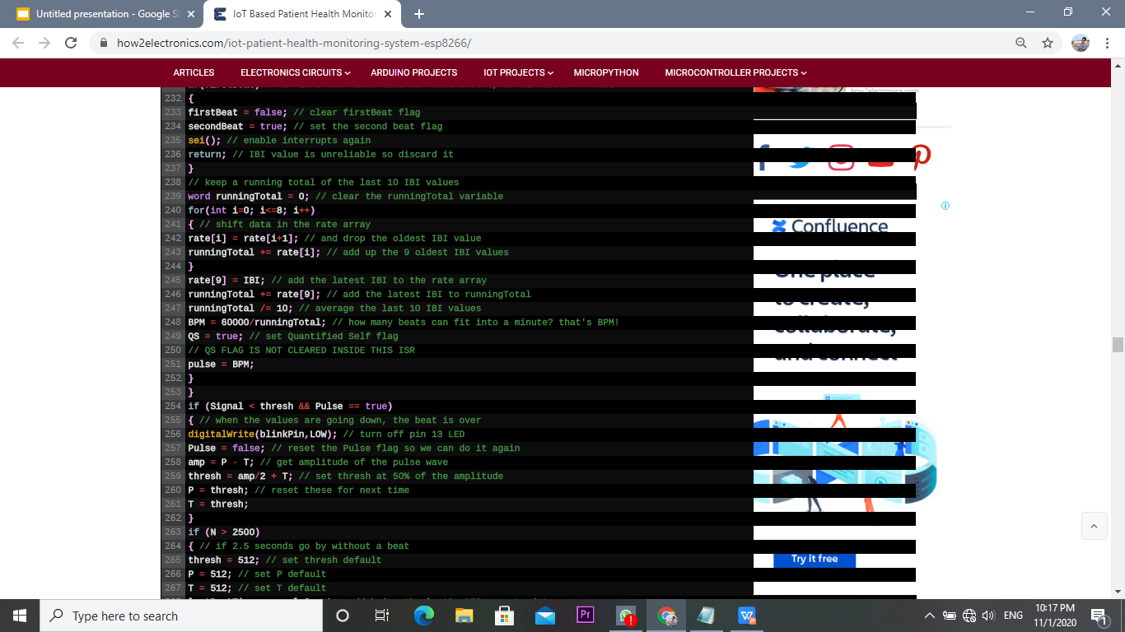

Slide 17
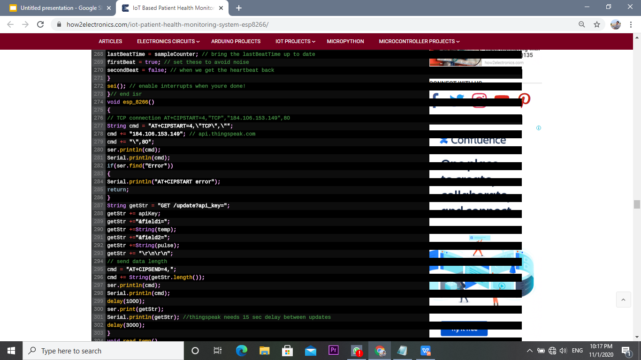

Slide 18
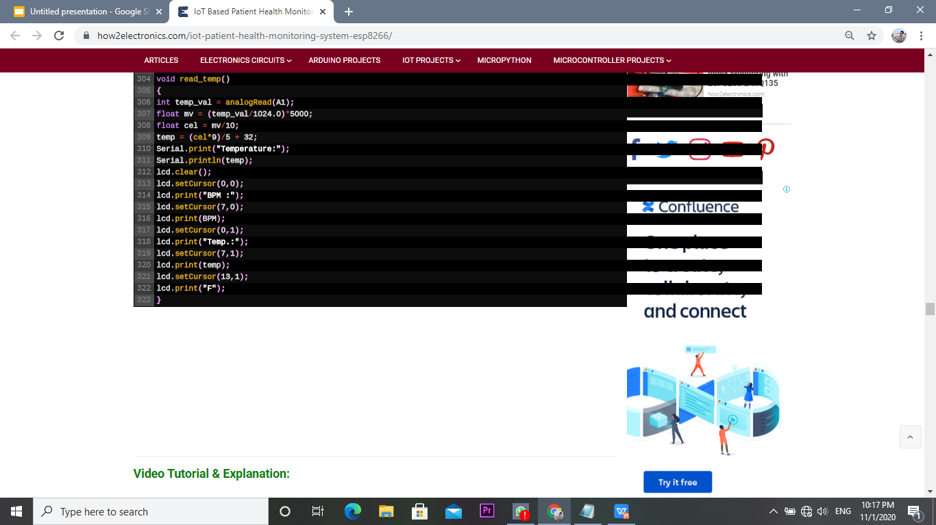

Slide 19
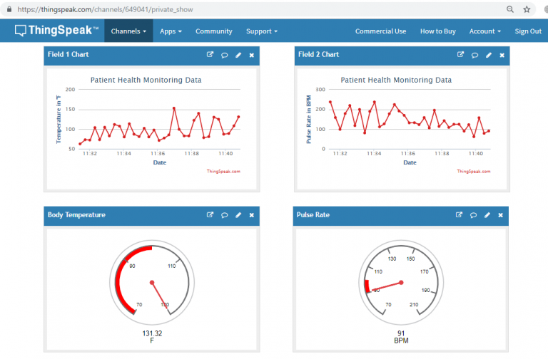
Model Output:

Slide 20
Reference:
Muhammad Wildan Gifari ; Hasballah Zakaria ; Richard Mengko: Design of ECG Homecare: 12-lead ECG acquisition using single channel ECG device developed on AD8232 analog front end, The 5th International Conference on ElectricalEngineeringand Informatics2015August10-11,2015,Baliindonesia,978-1-4673-7319-7/15/$31.00 ©2015 IEEE, pp 371-376.

Slide 21
Advantages:
Reduced Errors – IoT allows for the accurate collection of data, automated workflows and minimized waste, but most importantly it reduces the risk of error.
Decreased costs – With IoT, patient monitoring can be done in real-time, drastically cutting down the need for doctors going out and making visits. Connected home care facilities will also help reduce hospital stays and re-admissions.
Better patient experience – A connected healthcare system creates an environment that meets each patient’s needs. Dedicated procedures, enhanced treatment options and improved diagnosis accuracy make for a better patient experience.
Improved disease management – With real-time data healthcare providers can continuously monitor patients. This means that they can spot any disease before it spreads and becomes serious.

Slide 22
Conclusion:
In this project aims at initial prototype development for wireless transmission of Critical Parameters. It is evident that designing such a system will help in early detection of abnormal conditions of cardiovascular diseases and prevention of its serious consequences.

